Slide 1
Digital Portfolio
STUDENT NAME: VIJAYALAKSHMI.S
REGISTER NO AND NMID: autanm10910924ucsc019
DEPARTMENT: COMPUTER SCIENCE
COLLEGE: THIRUVALLUVAR ARTS AND SCIENCE COLLEGE /ANNAMALAI UNIVERSITY

Slide 2
PROJECT TITLE
DATA VISUALIZATION DASHBOARD

Slide 3


AGENDA
Problem Statement
Project Overview
End Users
Tools and Technologies
Portfolio design and Layout
Features and Functionality
Results and Screenshots
Conclusion
Github Link
3/21/2024 Annual Review

Slide 4

PROBLEM STATEMENT
Many individuals face challenges in presenting their skills, projects, and achievements in a structured and professional manner.
There is a need for an interactive and well-designed portfolio.

Slide 5

PROJECT OVERVIEW
This project is a personal portfolio website designed to showcase:
Skills
Projects
Achievements
Contact details

Slide 6

WHO ARE THE END USERS?
Students
Job Seekers
Freelancers
Professionals looking to showcase work

Slide 7
TOOLS AND TECHNIQUES
HTML, CSS, JavaScript
Frameworks: React (if applicable)
Backend: Node.js / Python (optional)
Database: MySQL / MongoDB (if used)
GitHub for version control

Slide 8
POTFOLIO DESIGN AND LAYOUT
Sections included:
Home
About Me
Skills
Projects
Contact
Designed for both desktop and mobile responsiveness.
‹#›

Slide 9
FEATURES AND FUNCTIONALITY
User-friendly navigation
Interactive project showcase
Contact form integration
Responsive design
Professional design elements

Slide 10
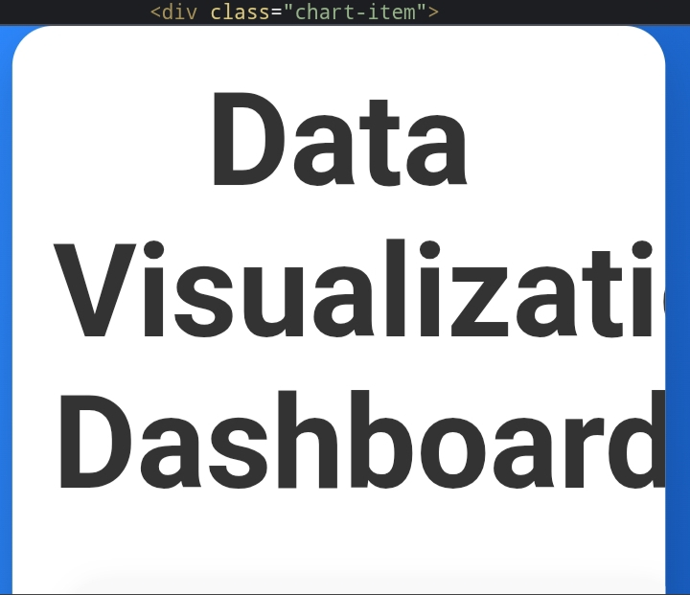
RESULTS AND SCREENSHOTS
3/21/2024 Annual Review
‹#›

Slide 11
CONCLUSION
The portfolio website successfully addresses the need for a professional platform to showcase skills and achievements.
‹#›

